Slide 1

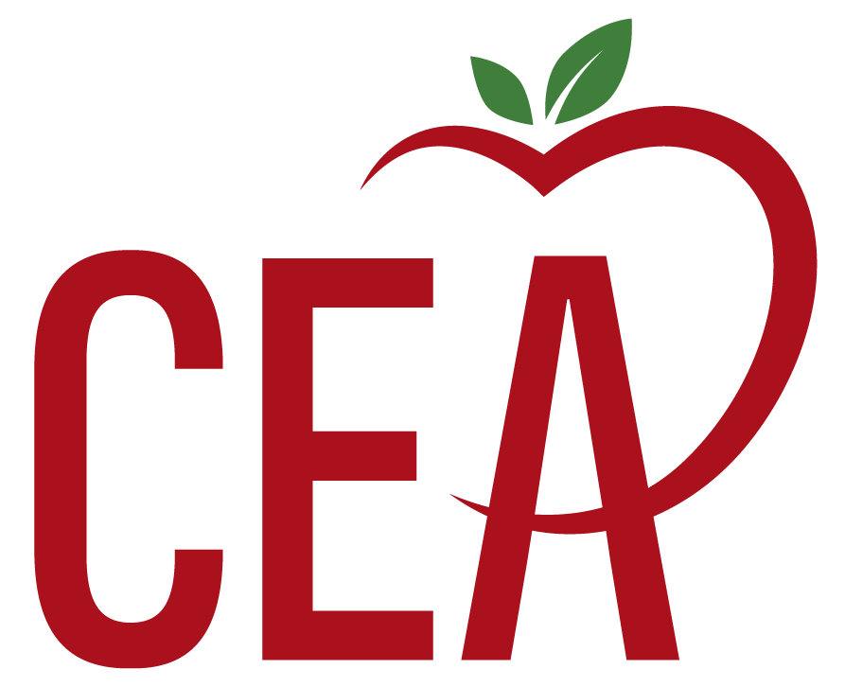
Tiered Supports & Corrective Action
Connecticut Education Association
Department of Policy, Research & Government Relations
Contact Kate Field at Katef@cea.org with questions

Slide 2

Educator Evaluation Guidelines
Support educator growth and agency
Allow for differentiation of roles
Simplify and reduce burdens
Focus on the growth of the whole child
Eliminate ratings and required SLOs
Notes:
Kate: The new guidelines represent a shift away from a one-size fits all approach to evaluation and away from a system that fosters compliance rather than growth. The new guidelines are intended to promote innovation and learning. Unlike the old system, the new guidelines can be differentiated to be relevant for educators in service provider roles like the school social worker. The streamlined and simplified approach is also designed to reduce paperwork and other burdens associated with the old system. Most importantly, the new guidelines allow educators to focus on the growth of the whole child, including their social emotional wellbeing and growth.

Slide 3
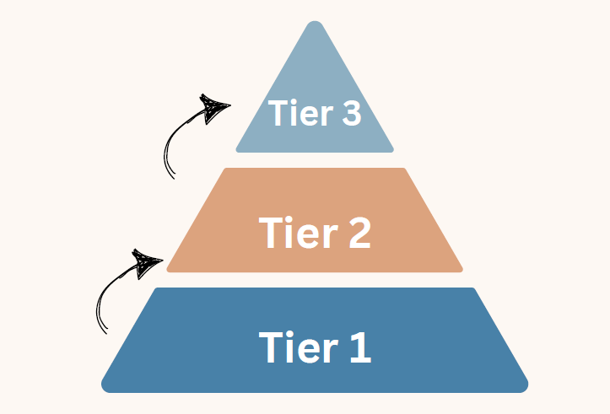
Tiered Support Process
Corrective Action

Slide 4
State Requirements for Corrective Action Plan
A pattern of persistent lack of growth and reflection or resistance to growth-oriented feedback should lead to advancing levels of support with a defined process for placing an educator on a corrective support plan with indicators of success for transitioning out of it. The corrective support plan shall be developed in consultation with the educator and their exclusive bargaining representative for certified teachers chosen pursuant to C.G.S. §10-153b.
Connecticut Guidelines for Educator and Leader Evaluation and Support 2023 (CT Guidelines 2023), p. 10

Slide 5

Tiered Support Requirements
The district PDEC plan should include samples of tier 1, 2, and 3 supports and be responsive to educator needs.
Utilize and document all three tiers prior to movement to a corrective support plan.
Ongoing training to ensure all stakeholders understand tiers, supports, and process (model of a corrective structure with tier 1, 2. and 3, supports should be provided in the appendix)
PDEC agrees upon orientation, training, and support elements for evaluators and educators on the critical components of success.
Connecticut Guidelines for Educator and Leader Evaluation and Support 2023 (CT Guidelines 2023), p. 11

Slide 6

Language from SRBI (a model for tiered support)
Tier 1 Tier 1 includes comprehensive/differentiated instruction informed by scientific research of the most effective methods for instruction and positive behavioral support.

Slide 7
What to Do When a Teacher is about to be Placed on Tier 2…
Read the section on tiered support in the district’s TEVAL plan and review the state requirements—is the required procedure being followed with fidelity?
Before a teacher advances to Tier 2, meet with the teacher. Was the teacher aware their evaluator had performance concerns? Is tier 2 a total surprise? If yes, this is a problem.
Review the feedback provided to the teacher. Is there evidence of a “pattern of persistent lack of growth?” Did the evaluator provide ongoing support matched to identified concerns (tier 1).
If movement to tier 2 is appropriate, ensure the teacher has an opportunity for input into what is most and least helpful.
In reviewing the support plan, look for: scope, pace, meaningful support, and objective criteria for success. Is the plan designed to help the teacher grow or will it stress them out (don’t weigh down someone struggling to swim—give them support to help them float).

Slide 8
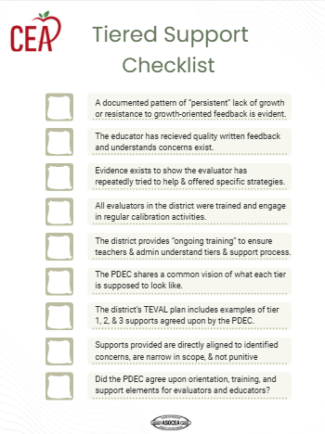
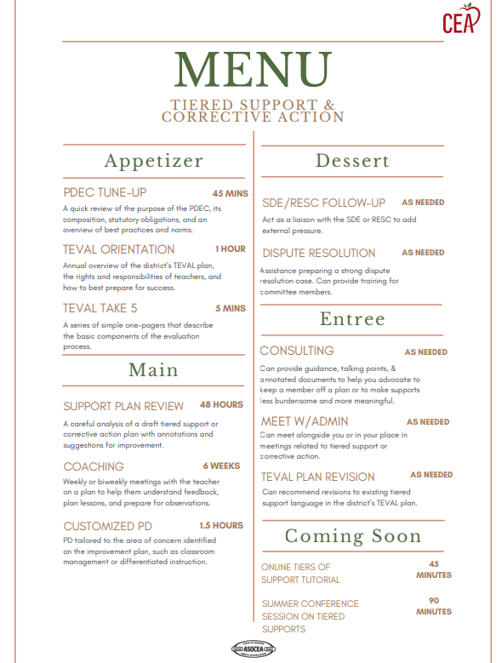

Slide 9
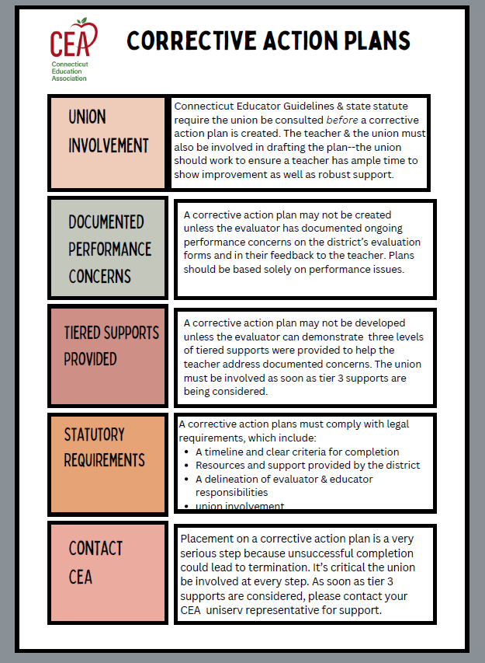
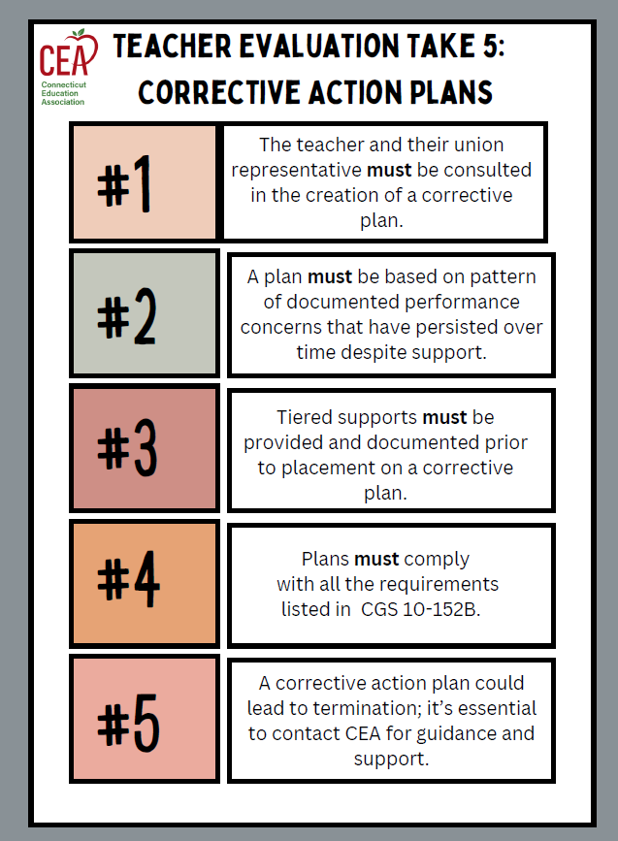

Slide 10

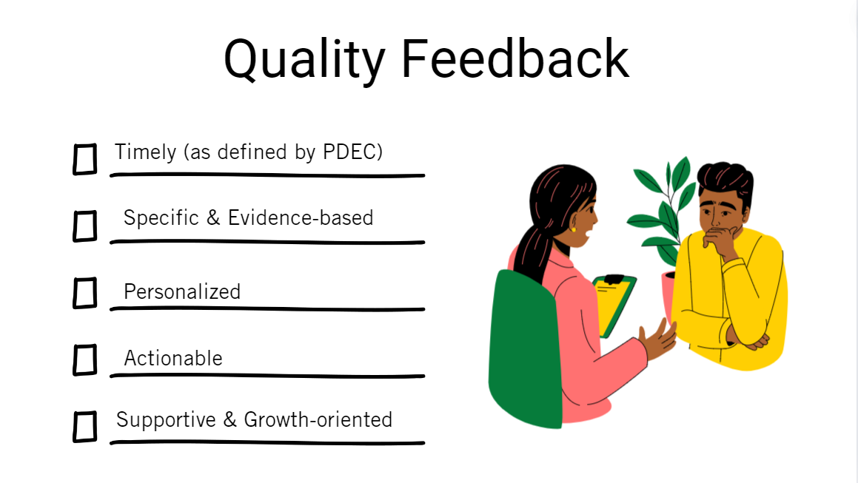


Slide 11
Focus on the PDEC & PD/Training
Ensure strong teacher representation on the PDEC, including different roles, buildings, and grade levels
Clear operating procedures, norms, a definition of mutual agreement
Annual review and revision of TEVAL plan based on input from teachers and admin
Agreed upon vision, language, & examples of tiered supports
PD planning for teachers & admin (CEA’s Professional Learning catalogue may be helpful). The PDEC should be involved in making the annual PD plan.
Ongoing training for all evaluators in growth-oriented feedback, tiered supports, and regular calibration activities
Consider CEA’s PDEC tune-up workshop

