Slide 1
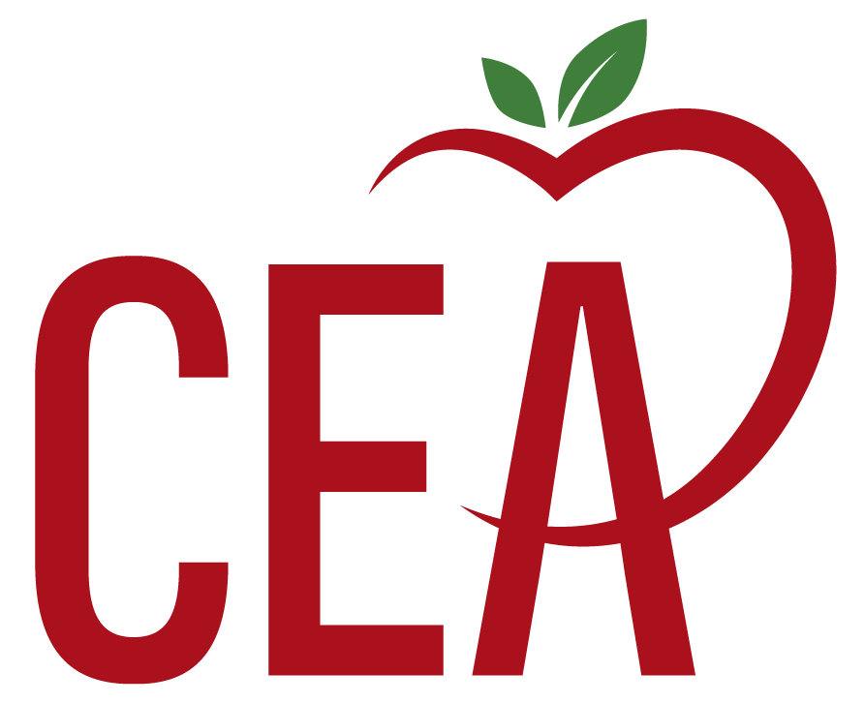
Preparing for a Successful Formal Observation
Connecticut Education Association
Department of Policy, Research & Government Relations
Kate Field, Teacher Development Specialist

Slide 2
Step 1: The Lesson Plan & Pre-Conference
Schedule a pre-conference with your evaluator even if it’s not required. Be sure to submit a written lesson plan for their review in addition to the required form(s). Use parenthetical references right on the lesson plan to show the domains and indicators of the observation rubric that your lesson will cover.
Make certain the learning objective is clearly stated, and the activities and assessments are clearly aligned to that objective.
Ask for feedback on the lesson plan so you can make necessary adjustments to it prior to the scheduled observation. Consider getting input from a mentor or trusted colleague as needed.
Be sure to plan for at least one formative assessment or quick check for understanding and clearly cite the appropriate indicator. Your evaluator will want to know you plan to assess students and adjust your instruction based on the results.
Be sure to thank your evaluator for their guidance.

Slide 3
Step 2: The Lesson
Make sure the lesson objective is clear to both students and your evaluator at the start of the lesson. Then revisit this objective as part of the lesson closure or exit ticket activity.
Show you have a positive, respective classroom atmosphere—use student names, affirm effort and participation rather than correctness, normalize mistakes as part of learning.
Actively engage students and avoid long stretches of direct instruction. Incorporate strategies like think-pair-share, turn & talk, four corners, quick writes.
Use strategic questioning that includes a mix of recall, application, and higher order thinking. Be prepared with questions like, “Why do you think that?” and “Who can expand on that idea?”
To maximize participation, utilize questioning strategies like, “Pause, Pounce, Bounce,” “Popcorn,” or “Whip Around.”
Focus on smooth transitions between activities and lesson segments by having materials ready and accessible. Ensure directions and provided in writing and verbally.
Be prepared for something that may not go well or as planned and have a back-up activity planned in case you need it.

Slide 4
Step 3: After the Lesson
Be ready to explain your decision-making.
Why did you choose specific strategies?
What data or reasoning guided how you grouped students?
How did the formative assessment data you gathered inform your next steps?
How do you know if your lesson objective was met for each student?
Be prepared to answer what you felt went well and what didn’t go as well.
Prepare one or two questions to ask your evaluator.
If you have areas your evaluator thinks you need help with, ask for suggestions or specific guidance. Seek out a trusted colleague, mentor, or coach for assistance.
Thank your evaluator for their feedback and expertise.

Slide 5
Quick Checklist
Is the learning goal clear and visible?
Are students doing most of the thinking?
Do I have at least one formative assessment or check for understanding?
Can an observer easily see student learning happening?
Is a respectful, positive classroom atmosphere evident?
Do I incorporate smooth transitions to reduce lost instructional time?
Do I have a back-up plan if an activity does not go as planned?
Do I have a closure activity that ties back to the learning objective?
Am I prepared to show I am reflective and receptive to feedback?
Do I know where to go or who to ask if I need help or additional guidance?

